Slide 1
ENFit® Product Conversion
Impacts all Enteral Feeding Tubing, Oral Syringes and Pharmacy Dispensing Products for Oral Medication

Slide 2
Purpose: Reducing Tubing Misconnections with ENFit®
There are several videos in this presentation. As not all workstations have speakers, please use the QR codes provided or utilize the Closed Caption features to get the most from these educational offerings.

Slide 3
Risk of Tubing Misconnections
An inadvertent connection between an enteral feeding system and a non-enteral system such as an intravascular catheter, peritoneal dialysis catheter, tracheostomy, medical gas tubing, etc.
Tubing misconnections can lead to severe consequences, including severe injury and patient death.

Slide 4
In Their Own Words: Families Impacted by Tubing Misconnections
https://youtu.be/7g4l8ryZCQk?si=0w2TeCi_AlDHIx1N

Slide 5
International Organization for Standardization developed ISO Standards
Standards are being developed for connectors that are mechanically incompatible with connections for other therapy modalities.
Vascular/intravenous to vascular/intravenous only
Respiratory connection standards
Neuraxial connection standards (called NRFit®)
Enteral to enteral only - this design is known as ENFit®

Slide 6
ENFIT ® conversion update
Who: All patients with an enteral feeding tube
What: ENFit® compatible = ‘Twist-in/Locking’ function
Where: Ultimately will impact all enteral tubes
Why: Improves safety:
Decreases risk of misconnections to other lines/devices (i.e. ENFit® only connects to ENFit®)
Decreases likelihood of disconnections
Standardization → Universal connector
When: Ongoing

Slide 7
New Products with ENFit® Connections
ENFit® Oral Syringes
ENFit® Feeding Tubes
ENFit Connectors Overview - YouTube

Slide 8
ENFit® vs Legacy Feeding Tubes

Slide 9
Syringe Comparison
NRFit® = Neuraxial specific administration devices

Slide 10
Pharmacy & Accessory Items
Bottle fill caps
Medication bottle adapters
Fill straws
Syringe caps
Tamper evident solutions
Prefilled syringes
Amber medication syringes

Slide 11
Medication administration
ENFit: Administering Medication in In-Patient Settings - YouTube

Slide 13
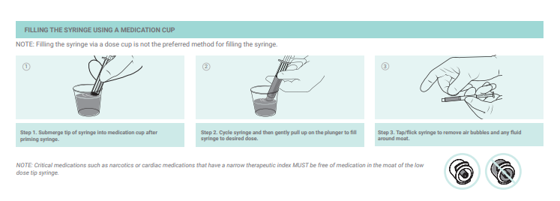

Slide 15
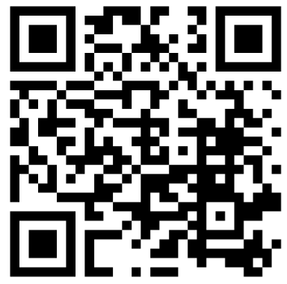
Cleaning the tube
https://youtu.be/WurJsuvpDKc?si=en4MeIl-34s9LqVk&t=23

Slide 16
Cleaning the tube
Because of the potential for formula, medication or breast milk to accumulate in the “moat” of the tube, it is recommended that the opening be cleaned 1-2 times/day.

Slide 17
Nebraska Medicine ENFit® Overview and Medication Preparation
https://www.youtube.com/watch?v=jBEZhXVWE5s

Slide 18
ENFit® Enteral System
Transition Sets requiring adaptor

Slide 19
Transition Connectors

Slide 20
Enteral Tube Insertion w/CO2 Detector
https://www.youtube.com/watch?v=JZGgAKxxZ9s&t=5s

Slide 21
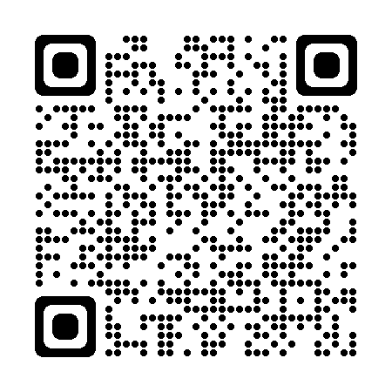
Adult Enteral Devices & Supplies – Transition & Adaptors
https://www.youtube.com/watch?v=Rkm9zecJwHY

Slide 22
Please reach out to your education team for questions.

